Slide 1
Hand Gesture Recognition Using Computer Vision
Presented by
Midhun P (TVE17EC027)
Sreejith S (TVE17EC049)
Vipin Chandran M (TVE17EC061)

Slide 2
Phase 1
Objective –
The intention of phase 1 of our project was to detect a hand (the colour of skin) from an image.
Algorithm –
Define range of HSV colour space co-ordinates for skin.
Read the image from the file source location.
Convert the image from BGR to HSV colour space.
Create a mask based on which pixels fall into specified upper and lower ranges.
Apply a series of erosions and dilations to the mask.
Blur the mask to remove the noise, then apply mask to the frame.
Show the skin in the image along with the mask.

Slide 3
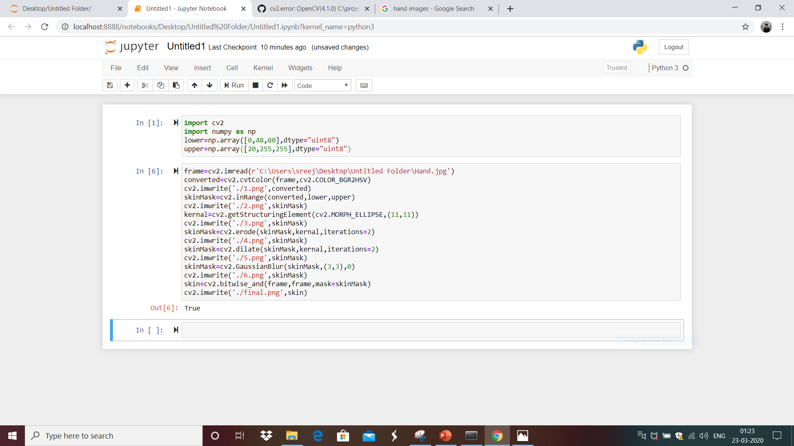

Slide 4
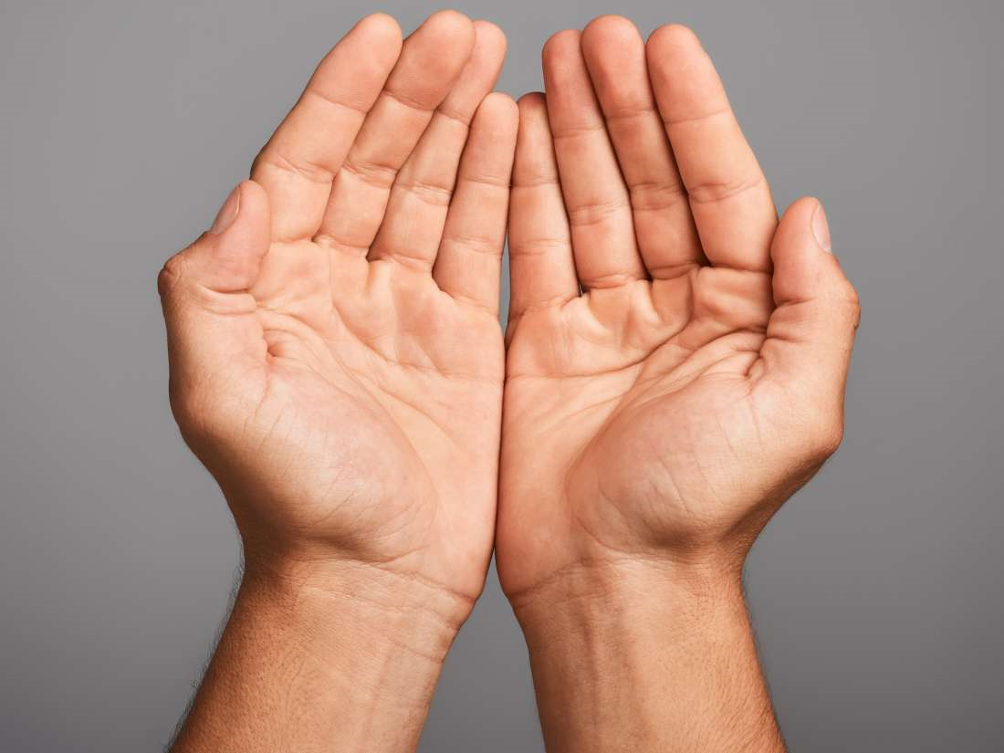
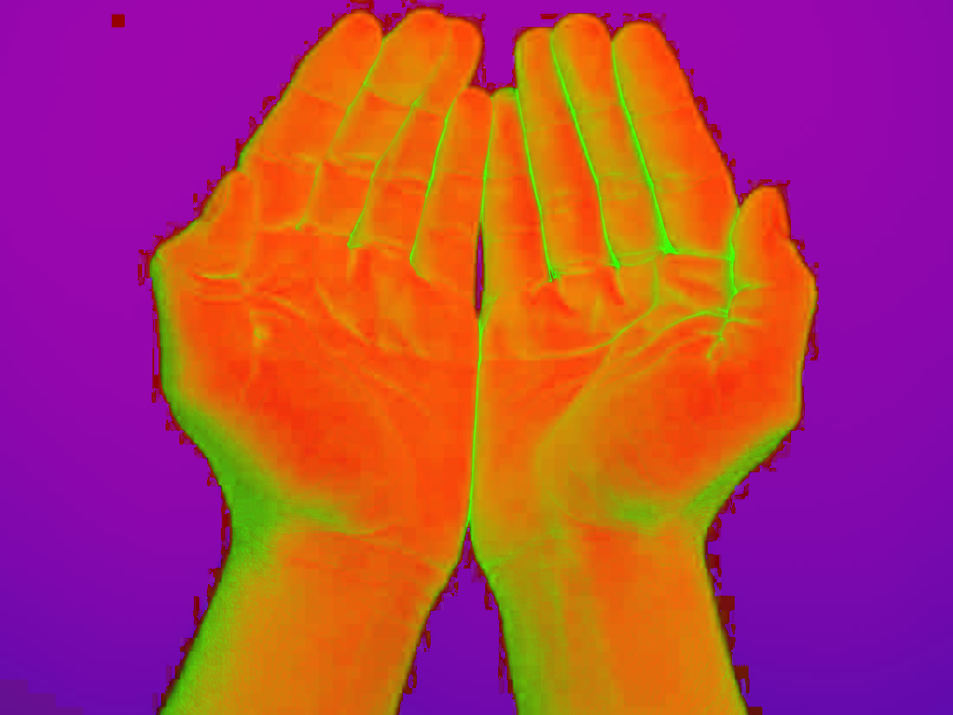




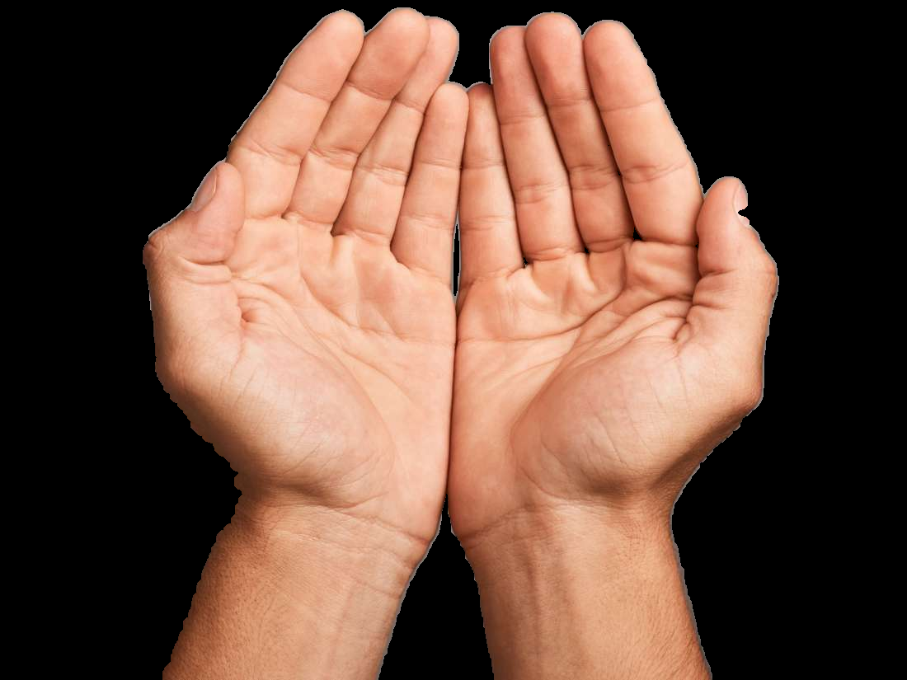
Phase 1 results
Hand.jpg (Input image) 1.png 2.png 3.png
4.png 5.png 6.png final.png (Output image)

Slide 5
Phase 2
Objective –
The purpose of phase 2 of our project is to recognize different hand gestures from a live video.
Algorithm – (only additions to phase 1 of the project are mentioned below)
Open camera and capture frames from it.
Create a binary image where white will be skin colours and the rest is black.
Find contour with maximum area and create a bounding rectangle around that contour.
Find convex hull.
Use mathematical calculations to find the number of convexity defects.
Show required images and print number of fingers.
Close the camera if 'q' is pressed.

Slide 6
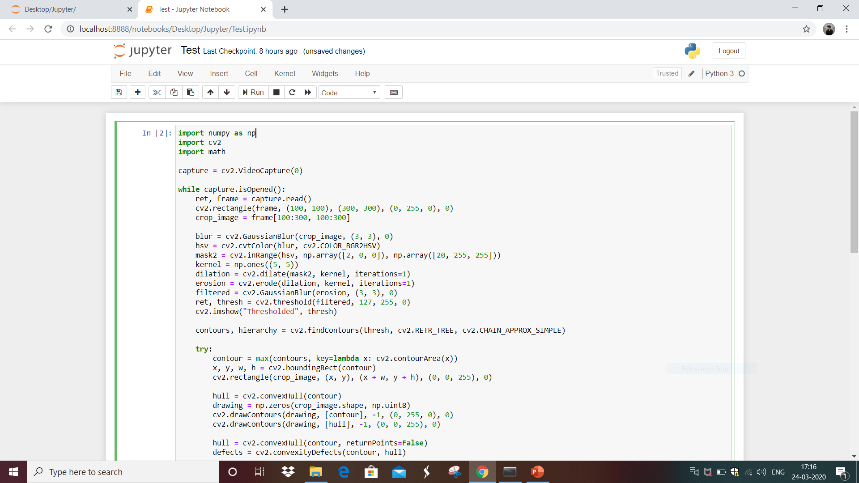

Slide 7
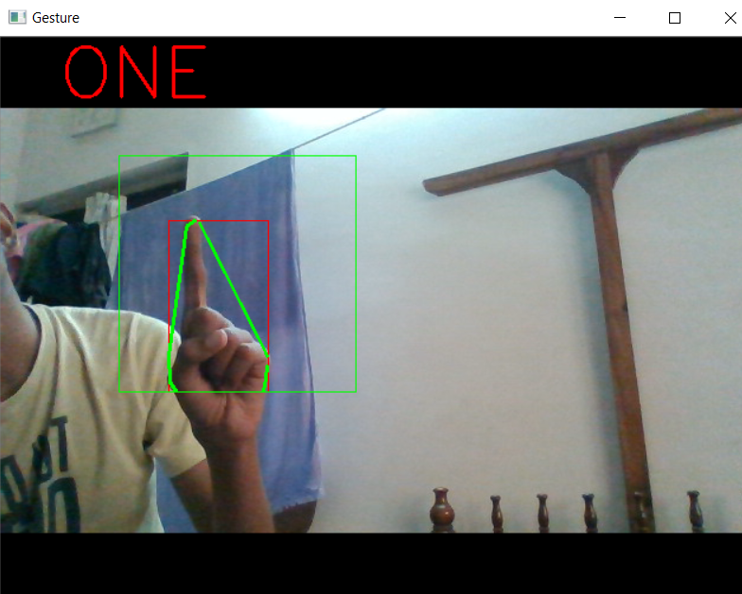
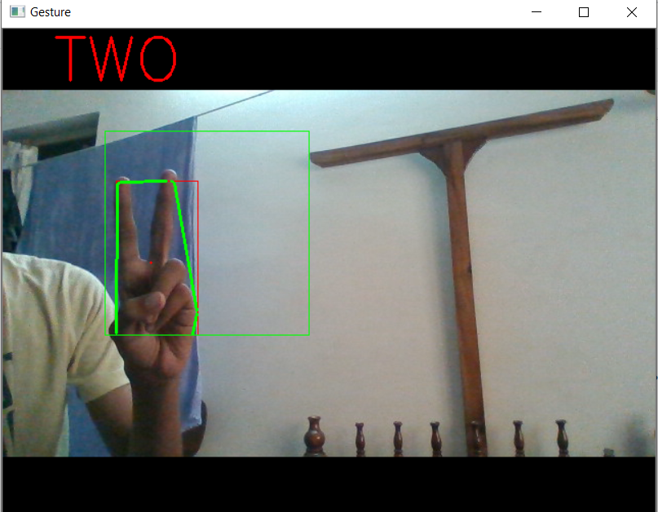
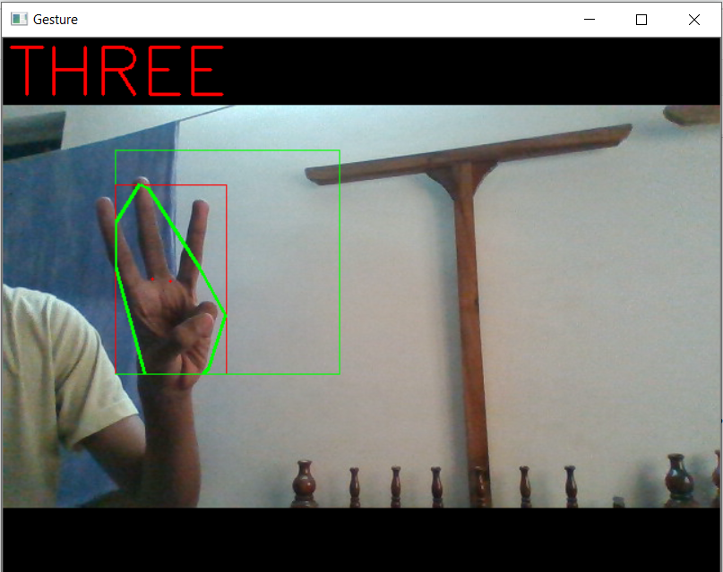
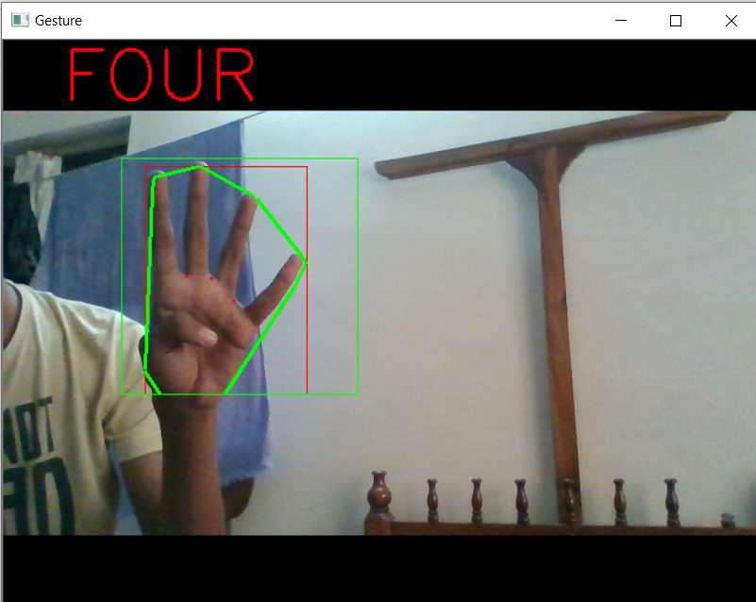
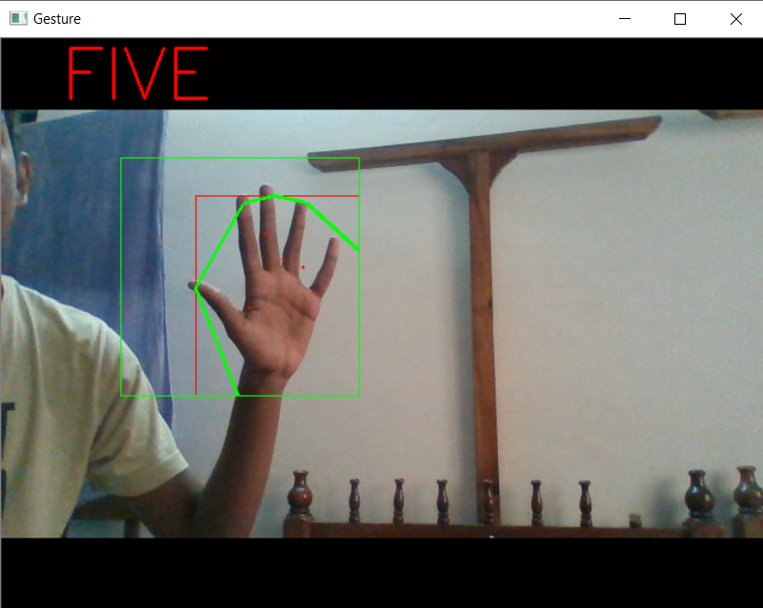
Phase 2 results
Gesture 1 Gesture 2 Gesture 3
Gesture 4 Gesture 5

Slide 8


